Slide 1



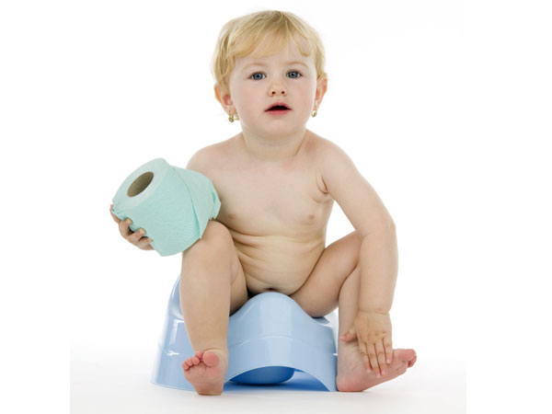
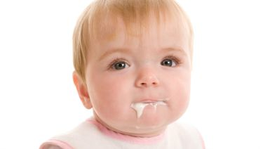
BY
Dr. Ashraf Mohamed El-Saghier
M.D. pediatrics
Diarrhea in pediatrics

Slide 2
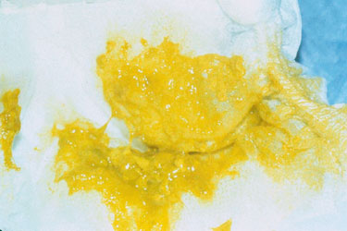
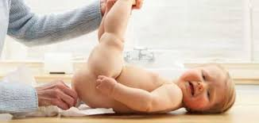
Definition and Epidemiology
Definition:
Increase in fluidity, volume, and frequency of stool. Greenish stool without change in consistency is not diarrhea.
Epidemiology:
The age incidence is between 3 months and 5 years. Diarrhea is common in summer and autumn, but less in winter and spring.

Slide 3
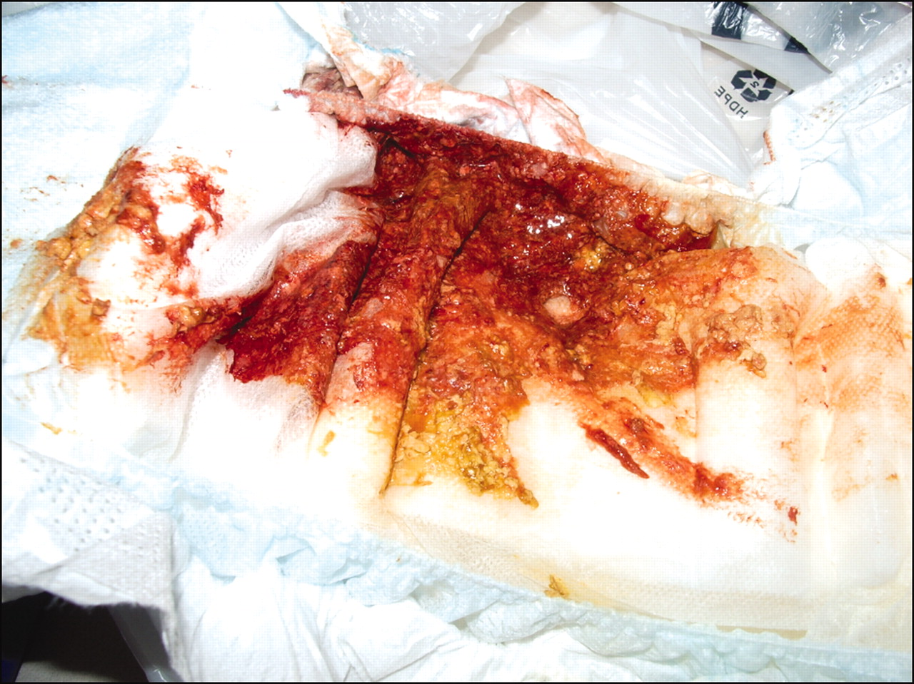
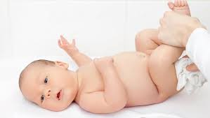
Clinical types
Clinical types
Acute diarrhea: lasts less than 14 days
Chronic diarrhea: lasts more than 14 days
Dysentry: diarrhea + visible blood in stool
N.B. excessive mucus alone is not suggestive of dysentery.

Slide 4
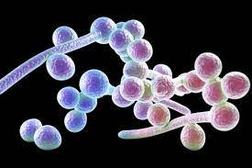
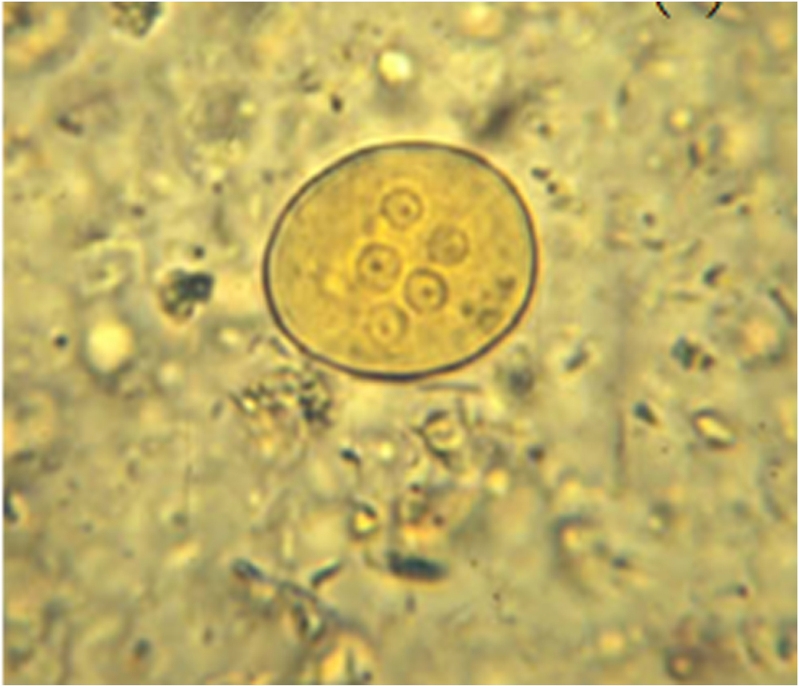
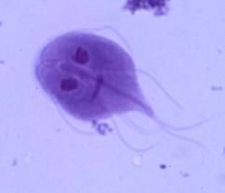
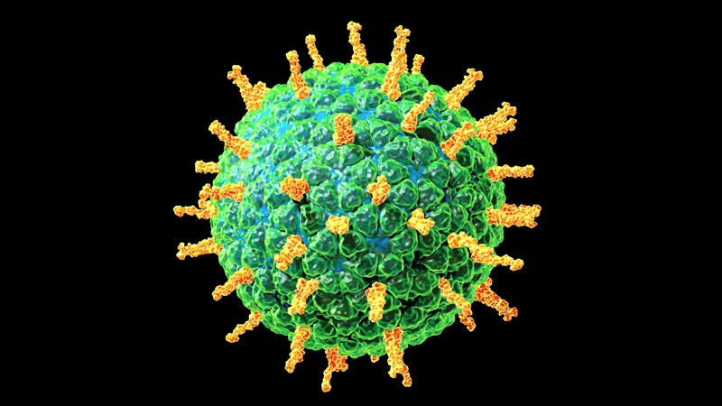

Etiology
Causes of acute diarrhea:
The causes of acute diarrhea may be infectious or non infectious
I- Infectious diarrhea
1- Bacterial: E-coli , Shigella, Cholera, and Salmonella.
2- Viral: Rotavirus, enterovirus.
3- Parasitic: Entamoeba histolytica and Giardia lamblia.
4- Fungal: Candida.

Slide 5
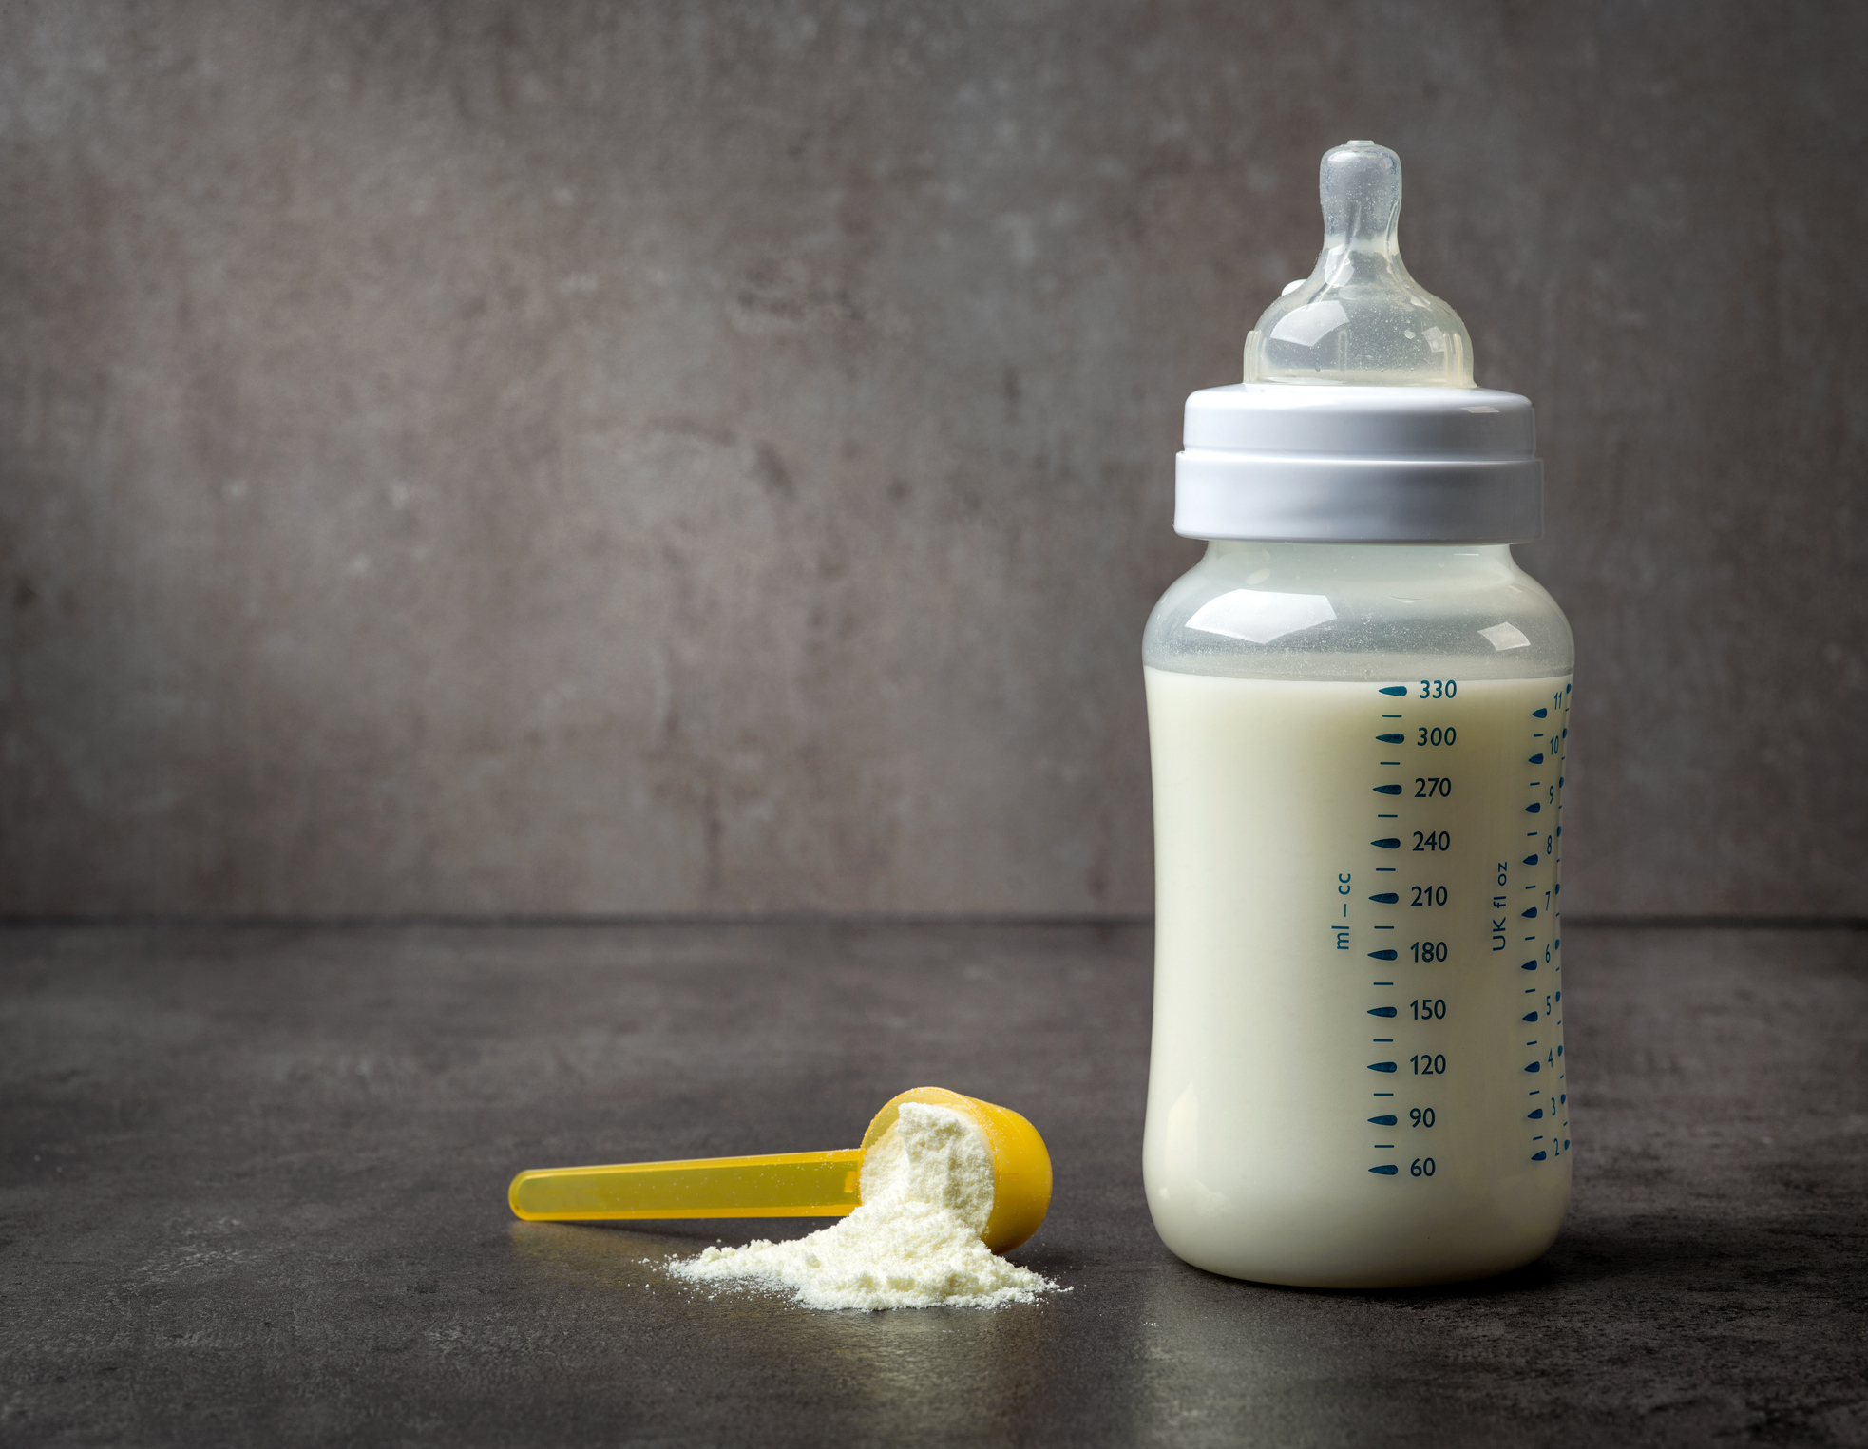
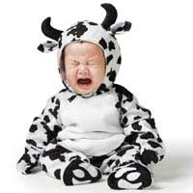
Etiology
II- Non infectious diarrhea
1- Feeding problems e.g.:
Overfeeding.
Over concentrated formula in formula - fed infants.
2- Cow milk allergy.
3- Poisoning e.g. insecticides Poisoning.
4- Lactose intolerance.

Slide 6

Etiology
Causes of chronic diarrhea:
1- Infection:
A- Bacterial e.g. TB and Salmonella.
B- Parasitic e.g. E.h. and Giardia.
C- Viral e.g. Rota virus in immunocompromised patients.
D- Fungal: Candida.
2- Intestinal enzyme deficiency.
3- Cow milk allergy.
4- Prolonged use of antibiotics.
5- Endocrinal disorders: e.g. thyrotoxicosis.

Slide 7
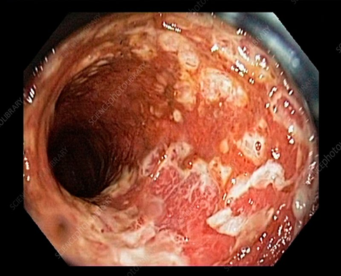
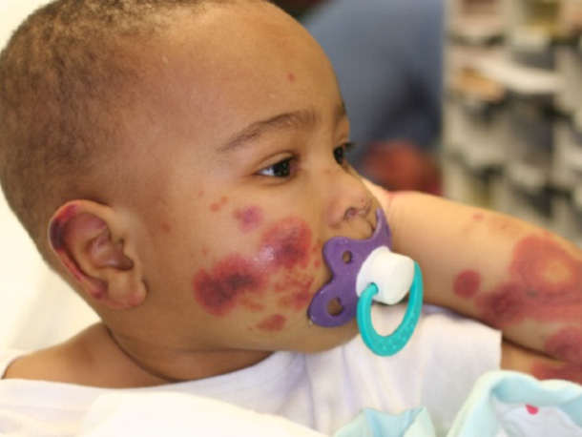
Etiology
Causes of bloody diarrhea
1- Infections e.g. shigella, bilharziasis, E. histolytica.
2- Cow milk allergy.
3- Bleeding tendency.
4- Intussusception.
5- Inflammatory bowel disease e.g. ulcerative colitis.

Slide 8
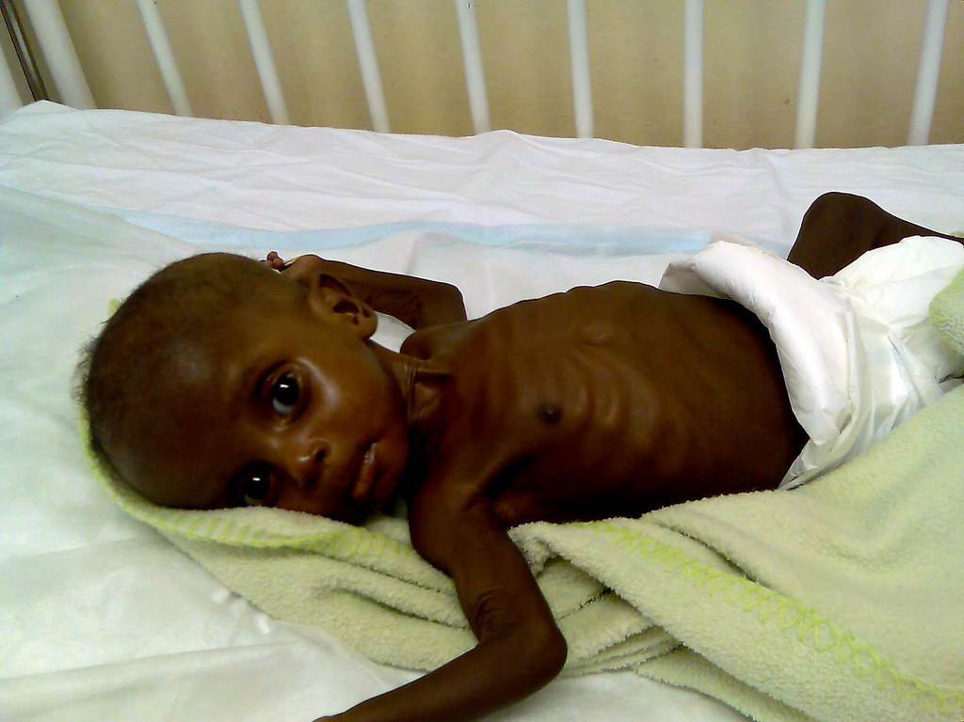
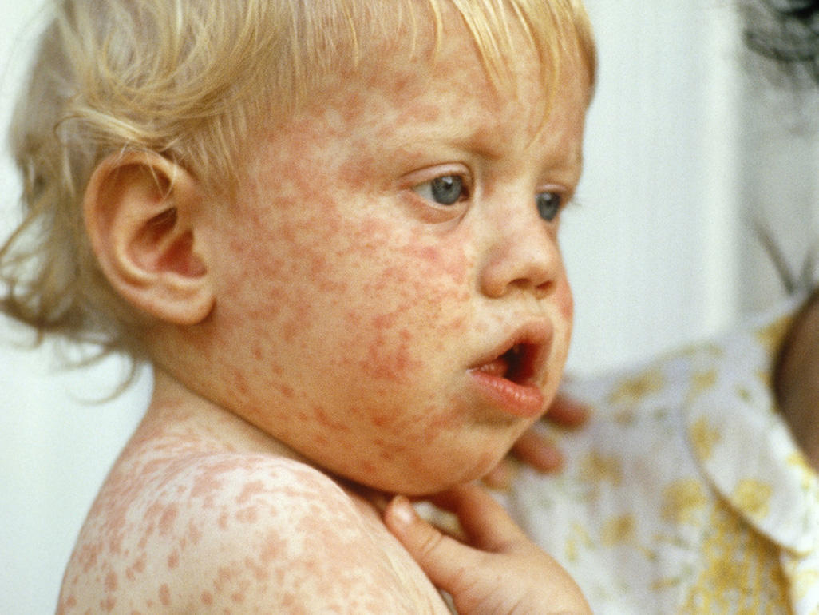
Risk Factors
I – Host Factors:
Age
Inadquate breast feeding
Malnutrition
Measles
Vitamin A def.
CMPA
Antibiotic use
Immunosuppression
II – Behavioral Factors
Contaminated formula or water
Improper sewage disposal and poor sanitation

Slide 9
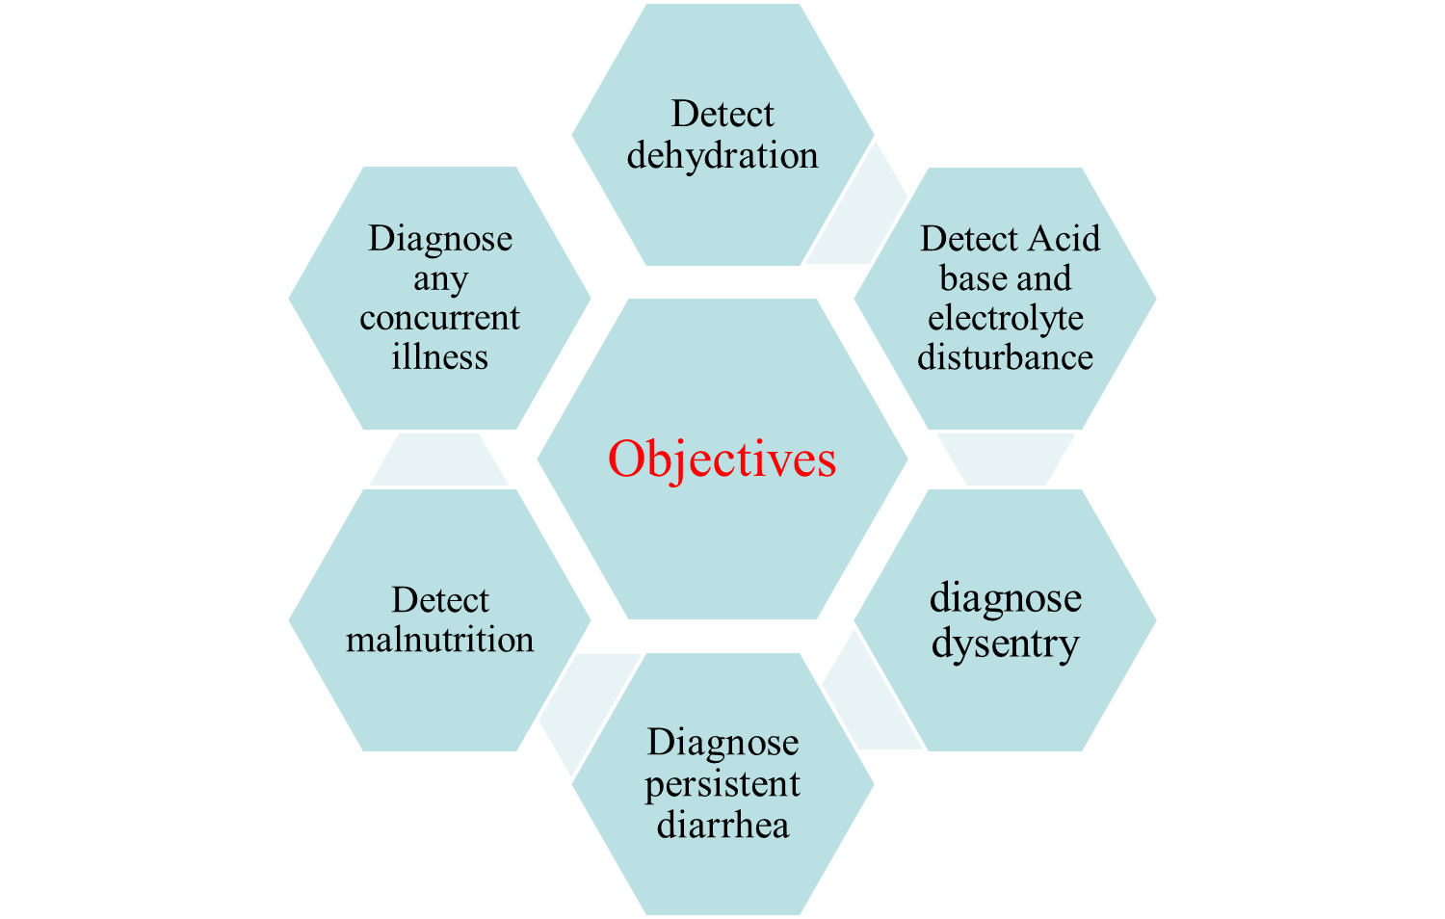
Clinical assessment

Slide 10
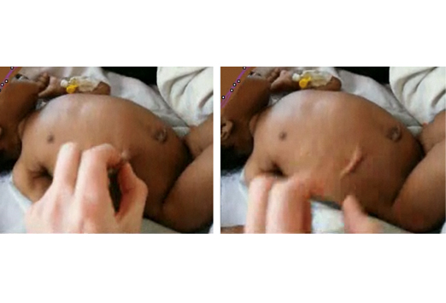
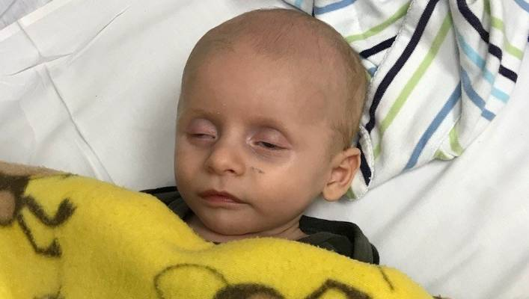
Complications
I- Dehydration:
Dehydration means deprivation of body fluids. It may lead to cardiovascular collapse and death.

Slide 11
Degrees and assessment of dehydration
Item | No dehydration Wt. loss<5% | Some dehydration Wt. loss 5 – 10 % | Sever dehydration Wt. loss >10%
General condition | Well, alert | Restless, irritable* | Lethargy, unconscious*
Eyes | Normal | Sunken | Very sunken, dry cornea
Tears | Present | Absent | Absent
Mouth and tongue | Moist | Dry | Very dry
Thirst | Drinks normal | Drinks eagerly* | Poor or unable to drink*
Skin pinch | Goes back quickly | Goes back slowly* | Goes back very slowly*
Treatment plan | Plan A | Plan B | Plan C
Other signs: pulse, blood pressure, skin, anterior fontanel, urine output

Slide 12
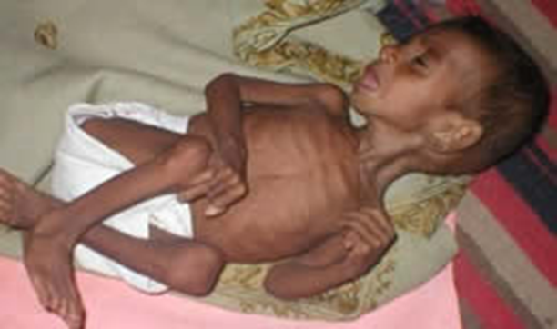
Complications
II- Metabolic and electrolyte disturbances:
include metabolic acidosis, metabolic alkalosis, hyponatremia, hypernatremia, hypokalemia, hypocalcemia, and hypomagnesemia.
III- Malnutrition:
Diarrhea produces malnutrition through:
Decreased food intake due to anorexia
Loss of nutrients in stool

Slide 13
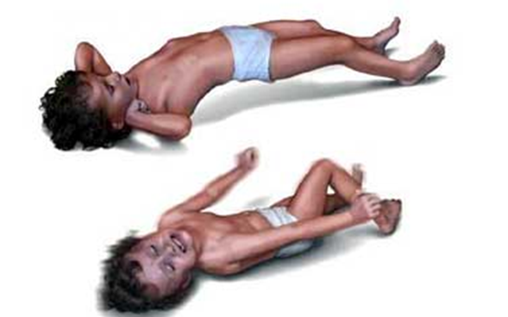
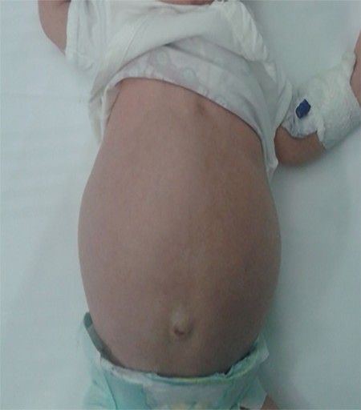
Complications
IV- Convulsions:
May be due to metabolic and electrolyte disturbances e.g. hypo or hypernatremia, hypocalcemia, hypomagnesemia, and alkalosis.
V- Abdominal distention:
It may be due to:
Paralytic ileus as a result of hypokalemia
Intussusception

Slide 14
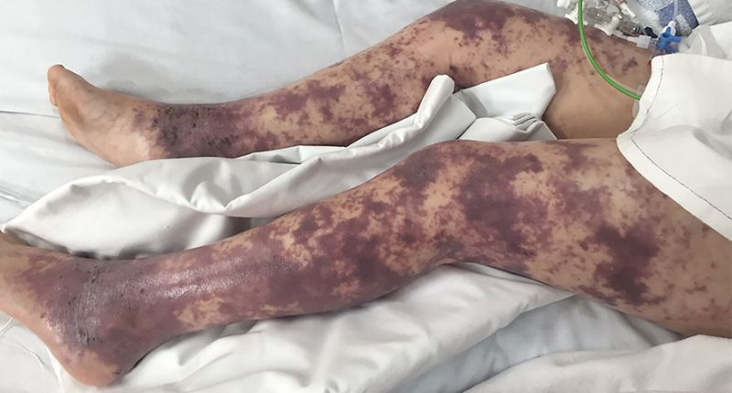
Complications
VI- Brain edema: may be due to:
Hyponatremia
Overhydration
Rapid intravenous infusion
VII- Disseminated intravascular coagulopathy:
It leads to consumption of coagulation factors and liability to bleeding.
VIII- Acute renal failure: due to hypovolemia.

Slide 15
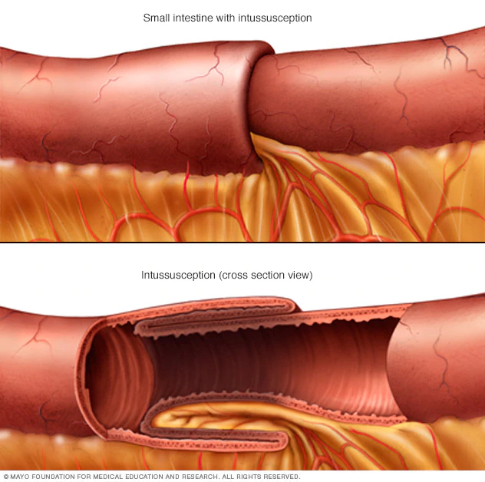
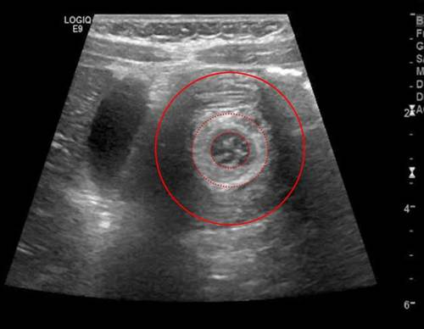
Complications
IX- Intussusception:
The child presents with abdominal distention, and colicky abdominal pain, preceding passage of red currant jelly stools. Intussusception may lead to intestinal perforation and peritonitis.
X- Septicemia

Slide 16
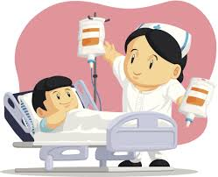
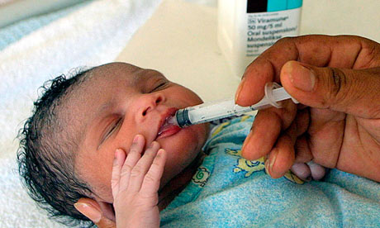
Treatment
Treatment of diarrhea includes:
A- Fluid therapy
B- Feeding
C- Additional therapies

Slide 17
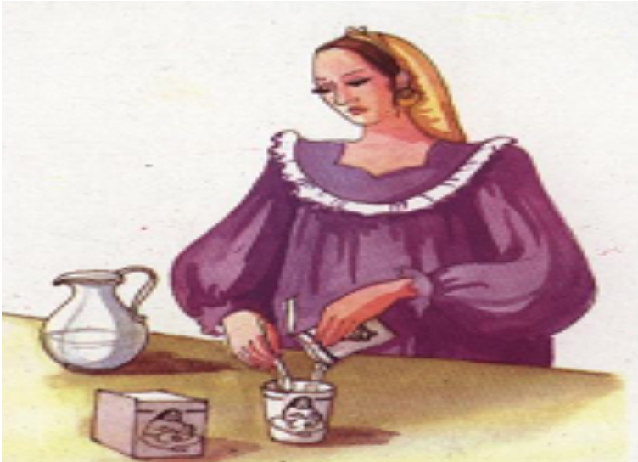
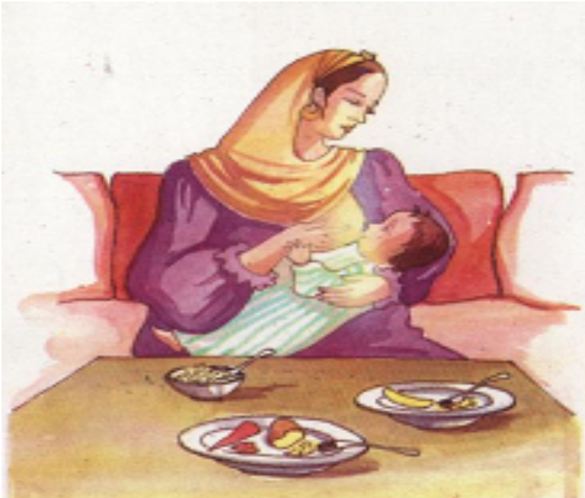
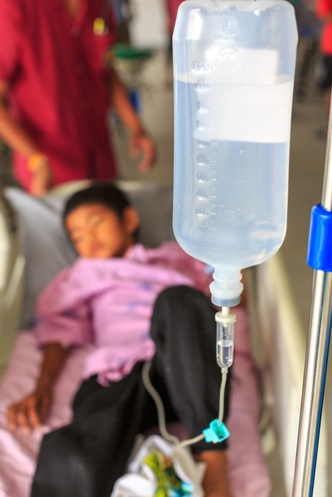
Treatment
A- Fluid therapy
Types of fluids:
Oral rehydration solution (ORS)
Home-made fluids
Intravenous fluids.

Slide 18
Types of fluids
ORS
Advantages
1- Effective in most cases
2- Suitable for all types of diarrhea and all types of dehydration
3- Used for all ages
4- Can be used even in the presence of vomiting.
5- Cheap and easily prepared.
ORS is usually given as one teaspoon every minute.

Slide 19
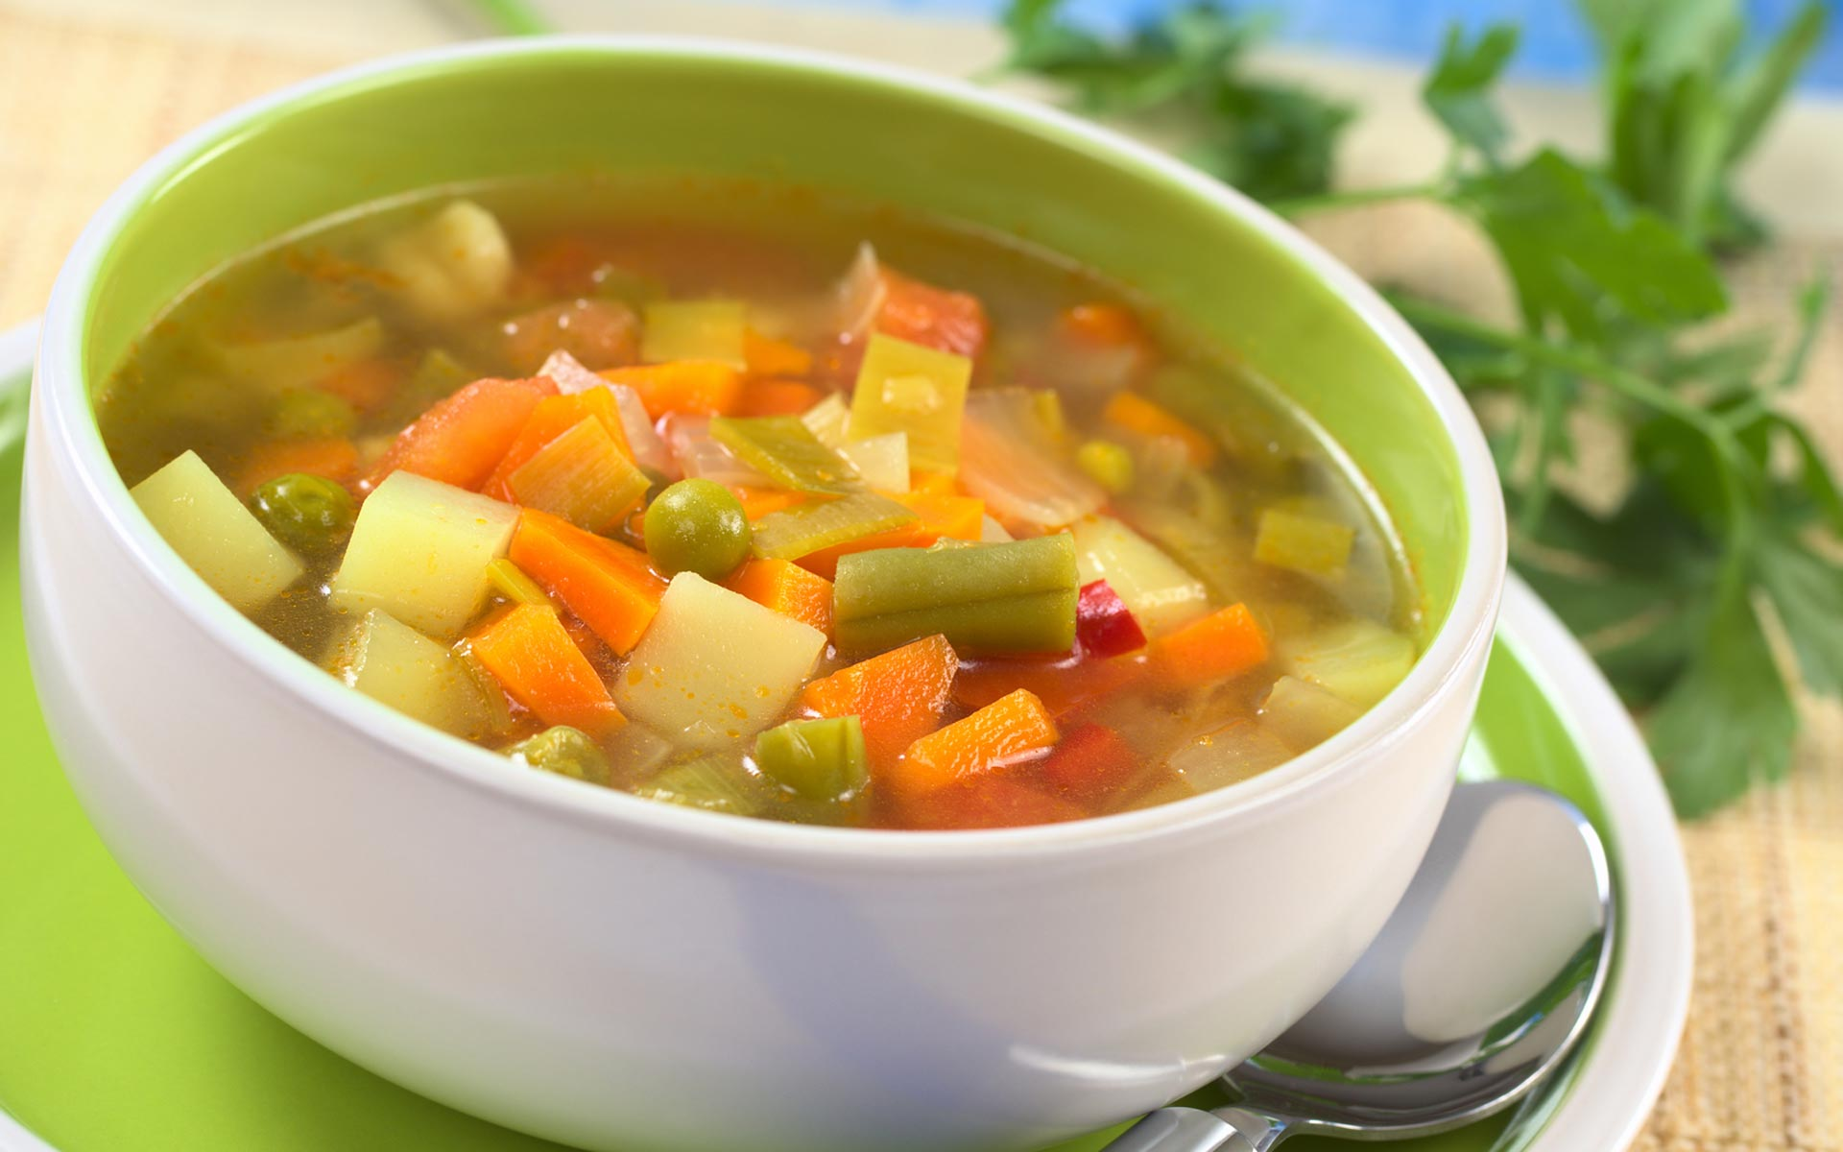
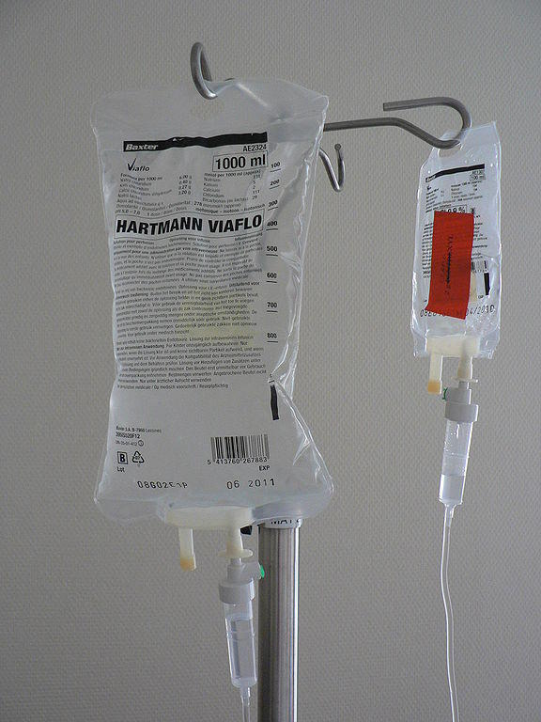
Types of fluids
Home made fluids:
These are fluids containing some salt with carbohydrates or protein, as soup and yoghurt. They should not be sweetened not to cause osmotic diarrhea.
I.V. fluids:
Polyvalent
Ringer’s lactate
Normal saline 0.9%
½ normal saline 0.45%

Slide 20
Plans of fluid therapy
Plan A | Plan B | Plan C
No dehydration | Some dehydration | Severe dehydration
ORS or Home made fluids | ORS | I.V. fluids or N.G. rehydration
At home | At hospital | At hospital

Slide 21
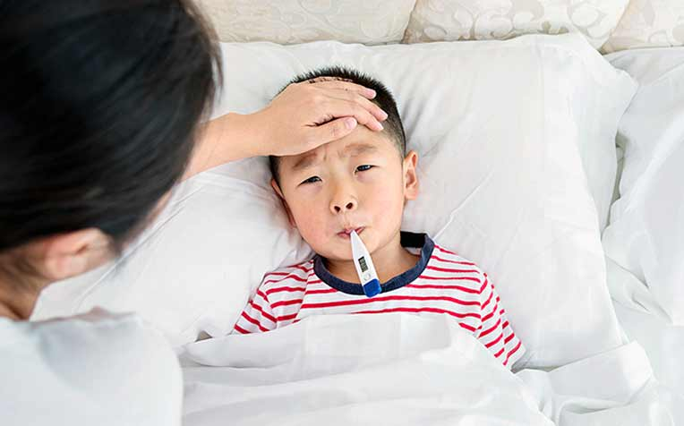
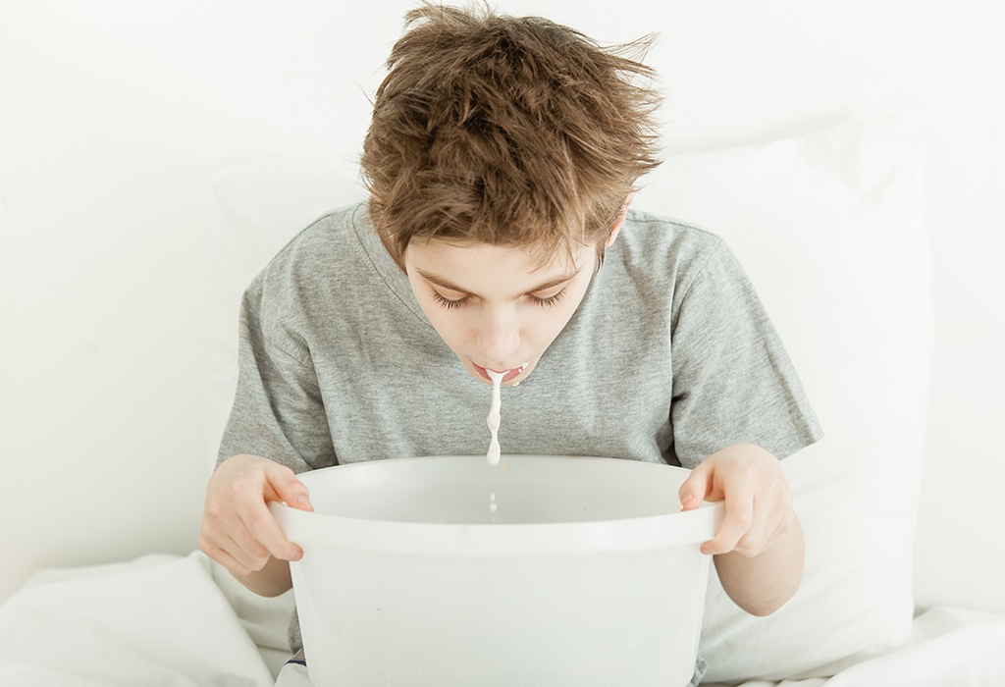
Plan A
For cases with no dehydration.
The mother should be instructed to:
Give the child more fluids (ORS or home made) to prevent dehydration.
Give the child plenty of food (breast, usual formula, solid food, cereals, fruits) to prevent malnutrition.
Referral to hospital:
1- Becomes worse
2- Drinking poorly
3- Fever
4- Blood in stool

Slide 22
Plan B
For cases with some dehydration. ORS is given at hospital with assessment of progress of the patient.
1- Replacement of deficit in the first 4 hours
The amount of ORS in the first 4 hours can be calculated as: weight in kg × 75 ml = …. ml.
Breast feeding is encouraged, but no other food is offered during this period. If vomiting occurs, wait 10 minutes, then give ORS slowly every 3 minutes.
2- Assess after 4 hours:
No signs of dehydration, shift to plan A.
Signs of some dehydration, repeat plan B.
Signs of severe dehydration, shift to plan C.

Slide 23
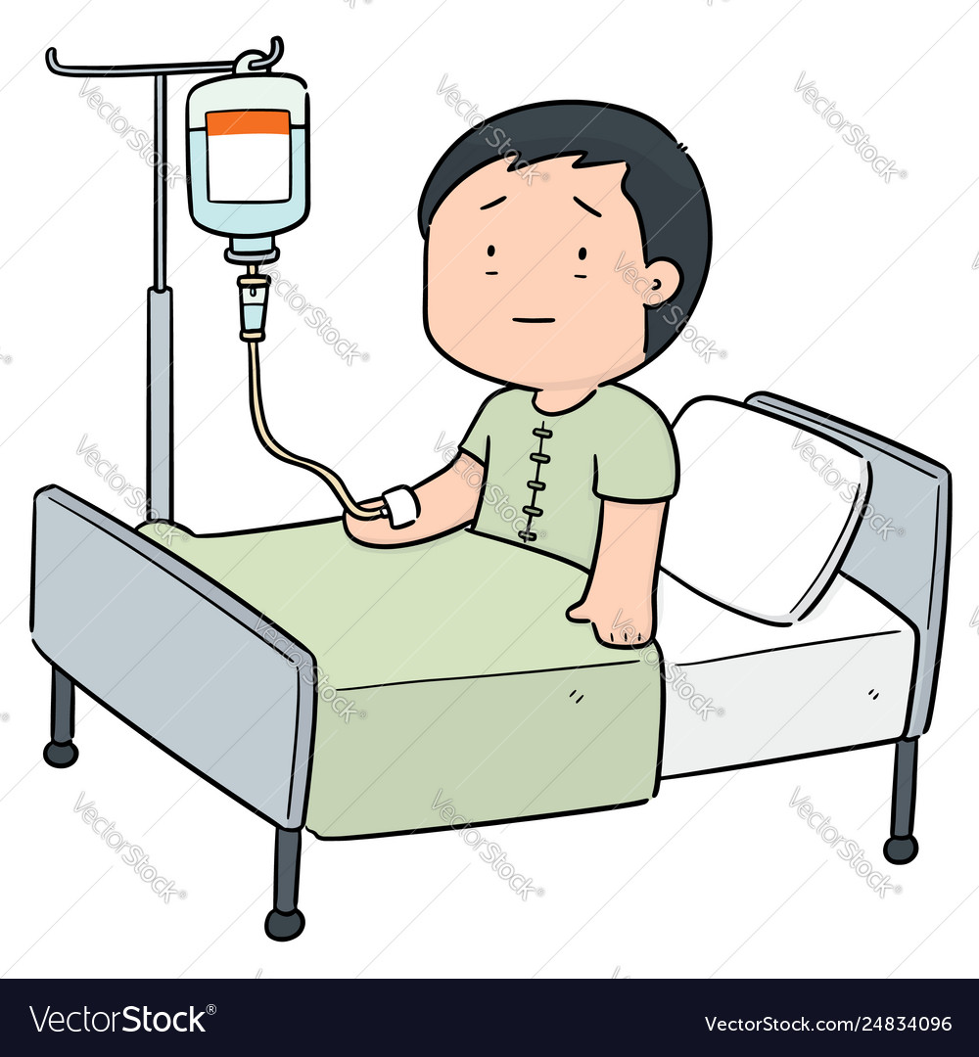
Plan C
I.V. or N.G. rehydration
Need hospitalization
Indications for I.V. fluids:
1- Severe dehydration
2- Failure of oral or nasogastric rehydration
3- Persistent vomiting (>4 times /hour)
4- Convulsions
5- Severe abdominal distention

Slide 24
Plan C
Small amounts of ORS are given by mouth as soon as the patient becomes able to drink.
▪ Complications of IV rehydration:
1- Electrolyte disturbances
2- Overhydration
3- Brain edema
4- Infection

Slide 25
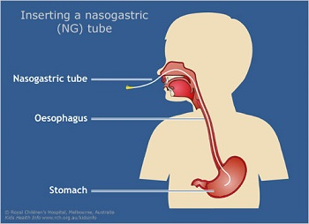
Nasogastric rehydration
Indications:
Failure of oral rehydration.
Persistent vomiting (>4 times /hour).
Severe anorexia or inability to swallow.
When the child refuses taste of ORS.
When the mother is tired.
In severe dehydration and I.V. fluids not available.
Amount of fluid: 20 ml/kg/hr for 6 hr (total 120 ml/kg)
Rate of drip = Wt. (kg) x 5 drop/minute
The child should be reassessed every 2 hours

Slide 26
Feeding during diarrhea
Early feeding and avoidance of fasting should be undertaken during treatment of diarrhea. Feeding during treatment of diarrhea does not increase the severity of diarrhea, but hastens recovery.
Advantages of continued feeding:
1- Stimulate secretion of digestive enzymes.
2- Enhance salt and water absorption.
3- Enhance repair and function of intestinal mucosa.
4- Prevents malnutrition.

Slide 27
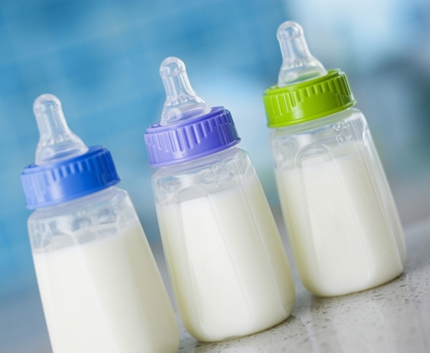
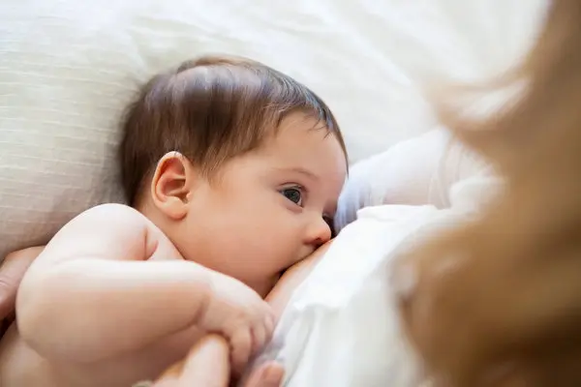
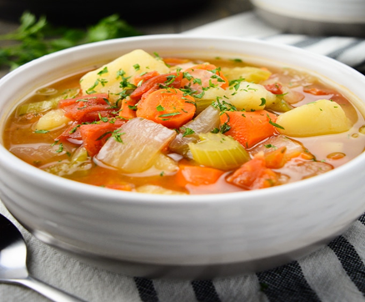
Feeding during diarrhea
Types of feeding
1- Breast feeding:
2- Formula feeding: is continued in full concentration.
3- Solid and semisolid foods: should be small, frequent, easily digestible as; rice, yoghurt, and vegetable soups.

Slide 28

Additional therapies
1- Antimicrobial therapy: is indicated in:
a- Parenteral diarrhea which complicates bacterial infections outside GIT such as; acute otitis media, and pneumonia.
b- Specific enteric bacterial infections such as; shigella, salmonella, and cholera.

Slide 29
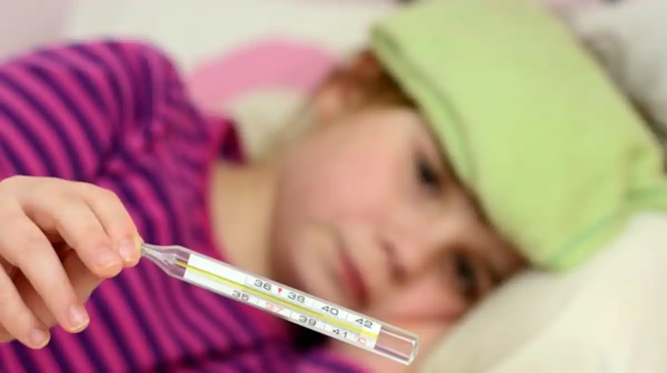
Additional therapies
2-Antipyretics: e.g. acetaminophen in case of fever, but the best antipyretics are good rehydration and cold compresses or water bath.
3- Anticonvulsants: in case of convulsions.
N.B. Antidiarrheal and antimotility drugs should not be given, as they may lead to paralytic ileus, and decrease elimination of microorganisms and their toxins.

Slide 30
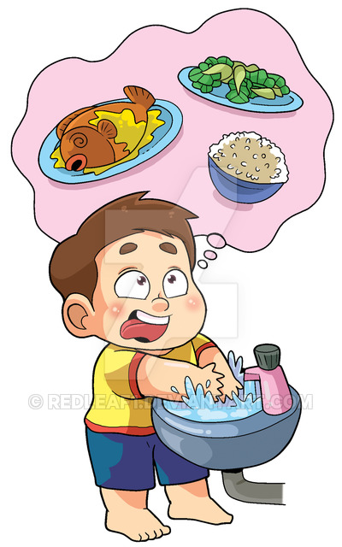
Prevention of diarrhea
1- Promotion of breast feeding.
2- Proper water supply.
3- Proper sewage disposal.
4- Washing hands.
5- Measles vaccination.
6- Improvement of nutritional status.
7- Rota virus vaccination.

Slide 31


